Slide 1
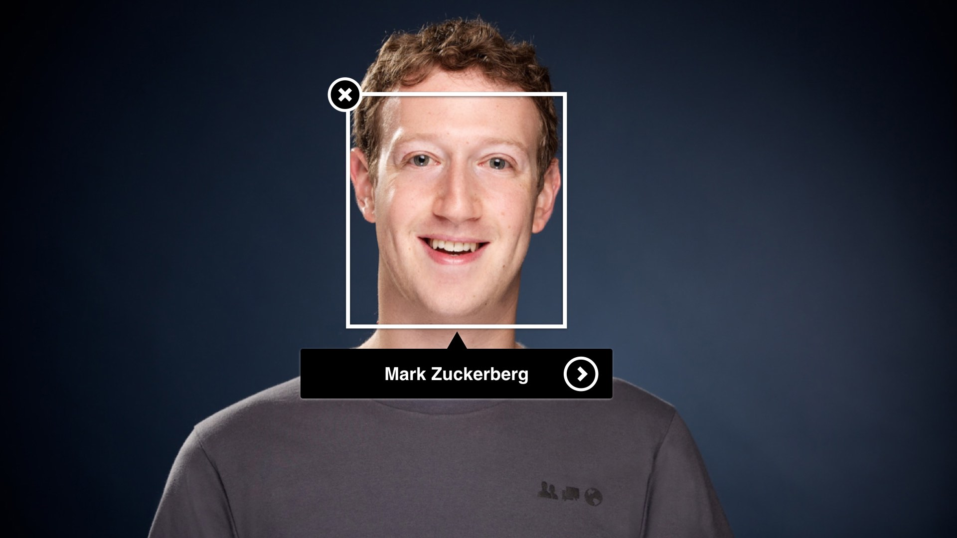

Facial Emotion Recognition
Happy
Prerak Lodha (RA2111026010394) Nimish Julka (RA2111026010408)

Slide 2

What is Facial Emotion Recognition?
Emotion extraction from faces uses computer vision and machine learning to analyze facial features and expressions. By training a model on labeled images of faces with emotions like happiness, sadness, or anger, the model can learn to recognize these emotions in unseen images. This technology has applications in areas like customer service analysis, human-computer interaction, and even mental health monitoring.

Slide 3
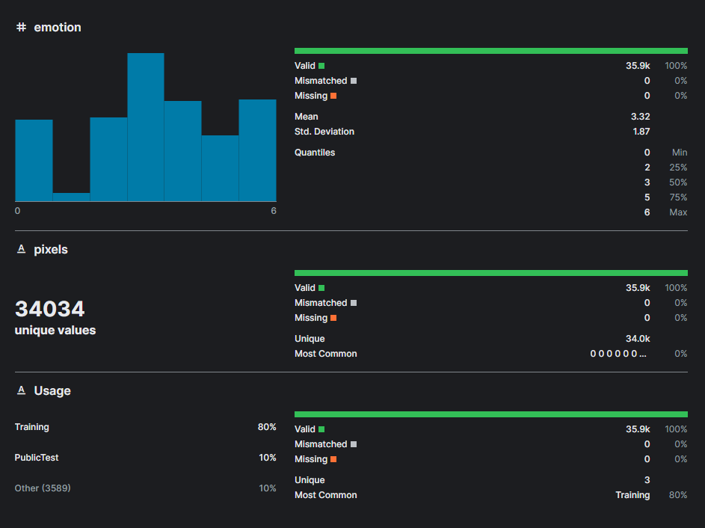
Dataset Kaggle - CSV
The dataset contains the following columns:
Emotion (String) - Can have any of the seven emotions (Anger, Disgust, Fear, Sadness, Happy, Surprised, Neutral)
Pixels (List[Integer]) - List of Grey Scale Pixel values of images
Usage (String) - Whether the image is for Training or Testing

Slide 4
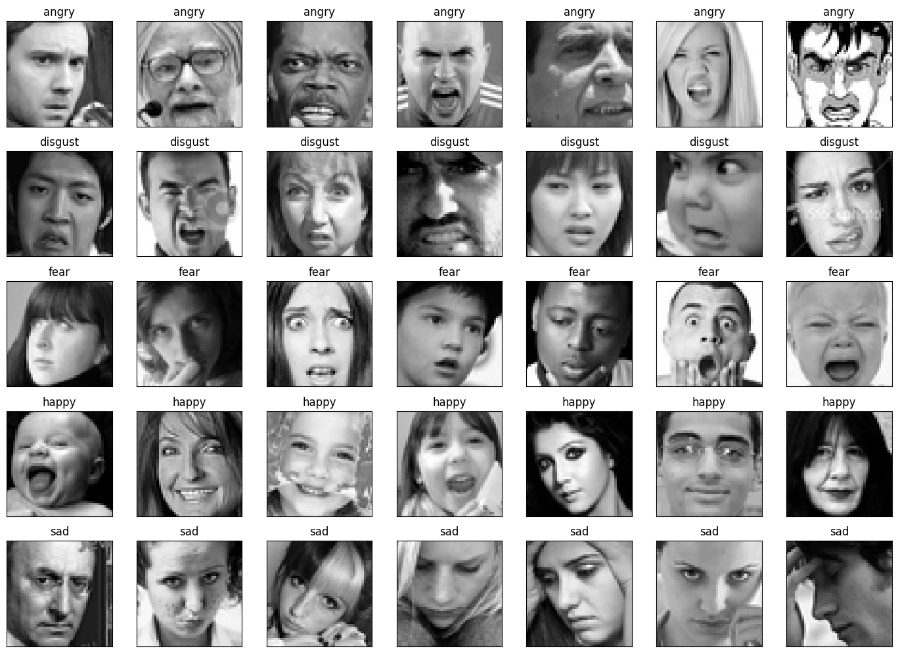
Image Dataset FER 2013 Dataset
Images of shape (width: 48, height: 48, channels: 1) labelled with the type of emotion displayed by the person.

Slide 5
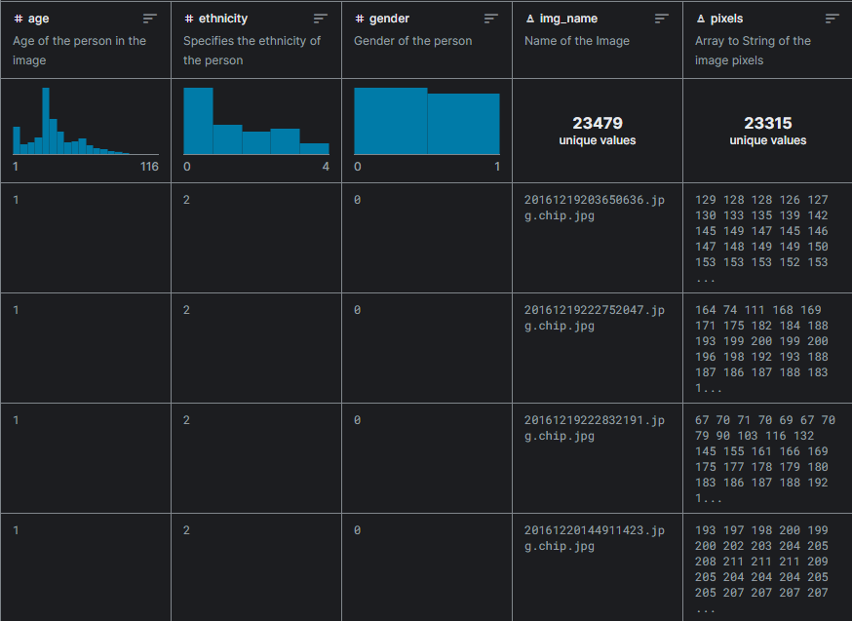
Dataset Kaggle - CSV
The dataset contains the following columns:
Age (Integer) - Has age ranging from 1 – 116 years.
Ethnicity (Integer) - 0: White, 1: Black, 2: Asian, 3: Indian, 4: Hispanic
Gender (Integer) - 0: Male, 1: Female
Img_name (String) - Name of image (redundant).
Pixels (List[Integer]) - List of Grey Scale Pixel values of images

Slide 6
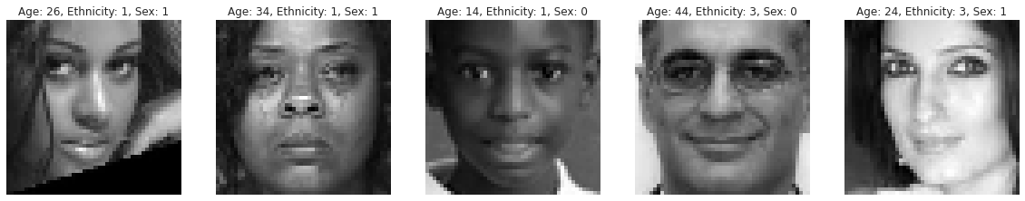
Image Dataset Age, Gender, Ethnicity Dataset
Images of shape (width: 48, height: 48, channels: 1) labelled with age, gender and ethnicity labelled.

Slide 7
Dataset Links
https://www.kaggle.com/datasets/nipunarora8/age-gender-and-ethnicity-face-data-csv/data
https://www.kaggle.com/datasets/ashishpatel26/facial-expression-recognitionferchallenge

Slide 8
Steps to build Facial Emotion Recognition Model
Import the Libraries and Dataset
Pre-process the dataset images
Create a Sequential CNN model
Evaluate the model
Run on live cam feed
Predict the emotions
Train the model

Slide 9
Steps to build Age, Gender, Ethnicity Recognition Model
Import
Import the Libraries and Dataset
Pre-Process
Pre-process the dataset images
Evaluate
Evaluate the model
Run
Run on live cam feed
Predict
Predict the age, gender, ethnicity
Train the model
Train
Model
Create a Sequential CNN model

Slide 10
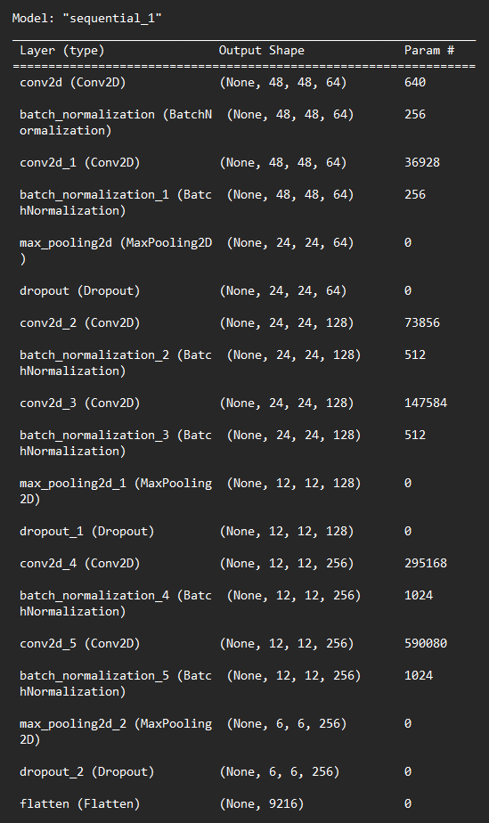
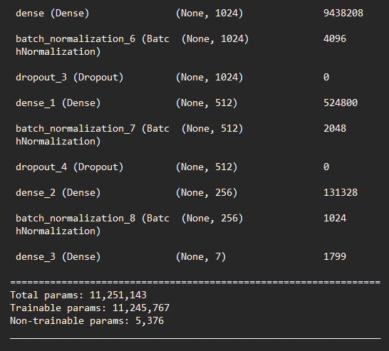
Model Architecture (Emotion)

Slide 11
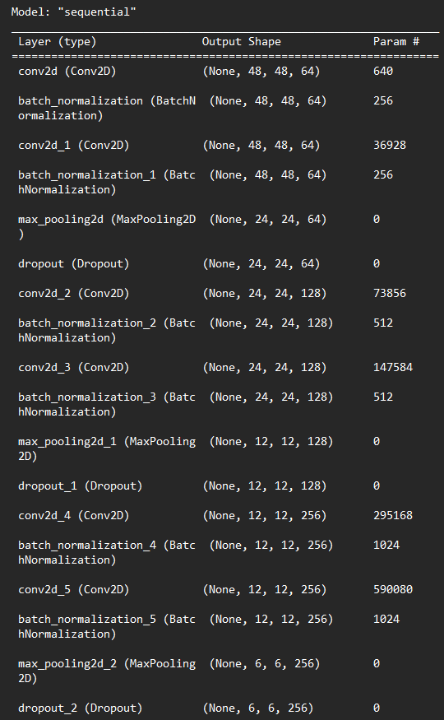
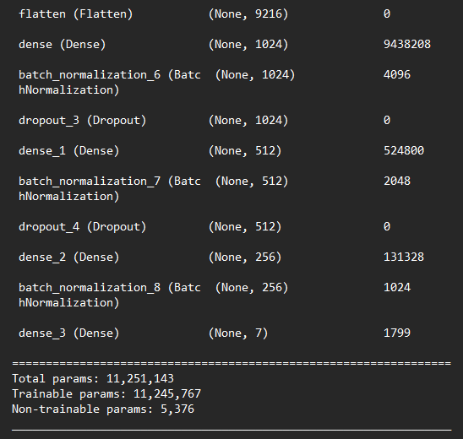
Model Architecture (Age)

Slide 12
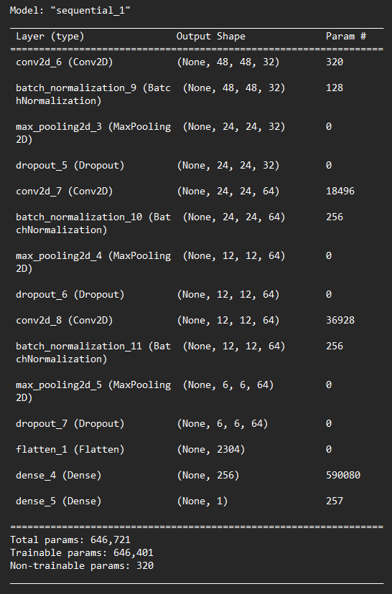
Model Architecture (Gender)

Slide 13
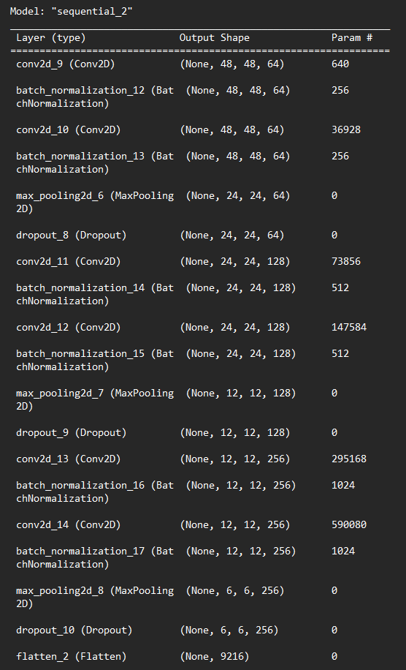
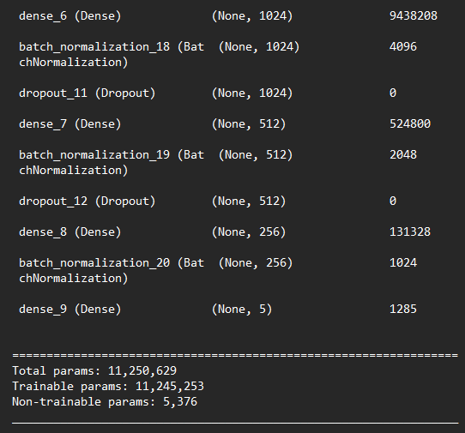
Model Architecture (Ethnicity)

Slide 14
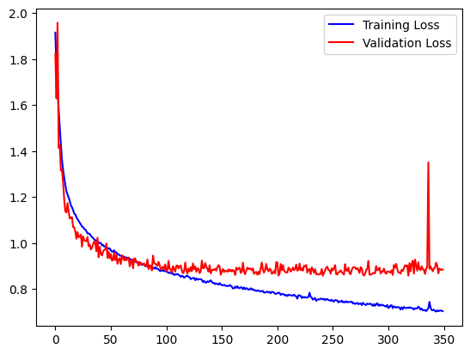
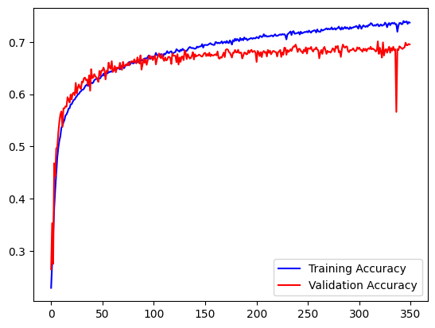
Training Graphs (Emotion)

Slide 15
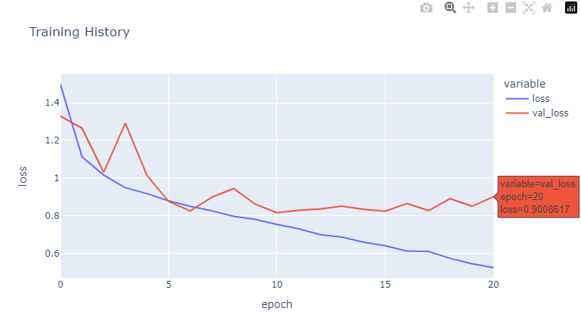
Training Graphs (Age)

Slide 16
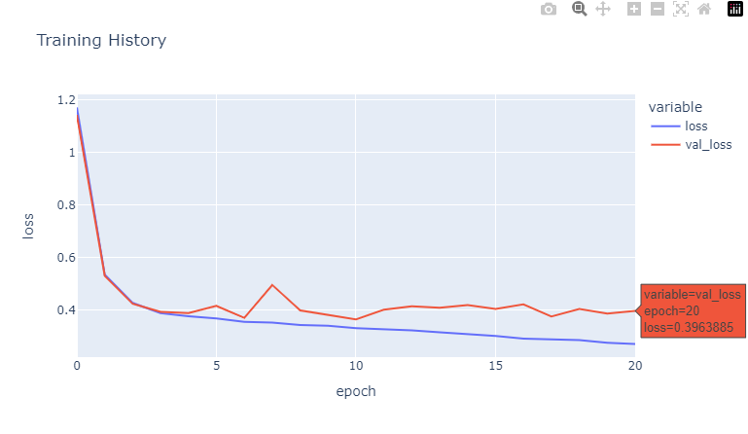
Training Graphs (Gender)

Slide 17
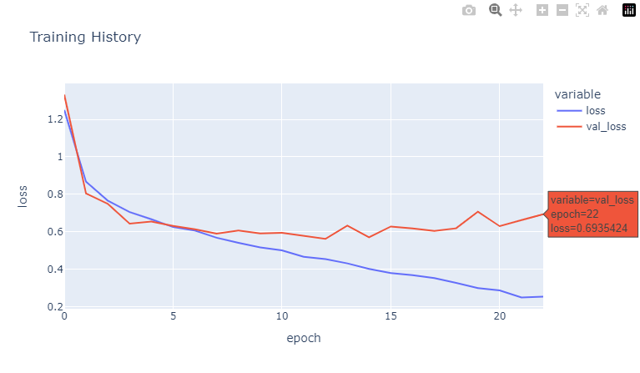
Training Graphs (Ethnicity)

Slide 18
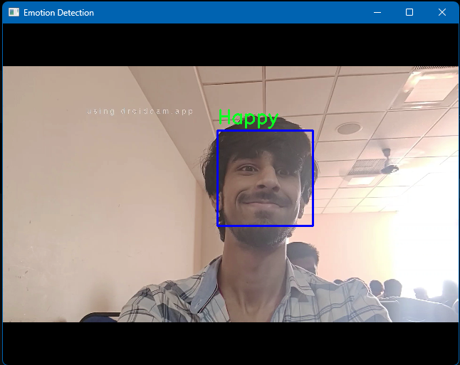
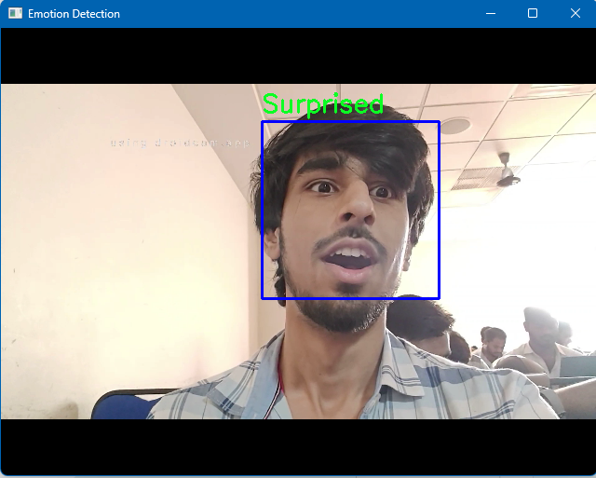
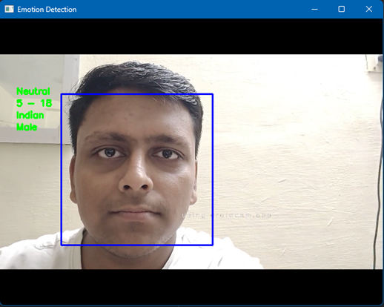
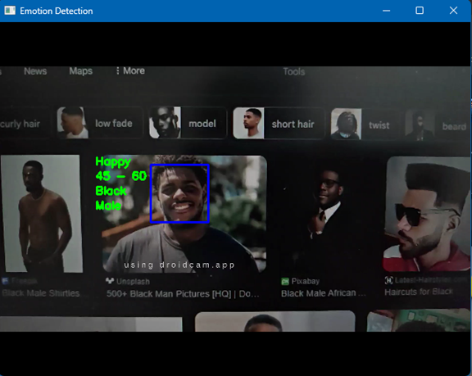
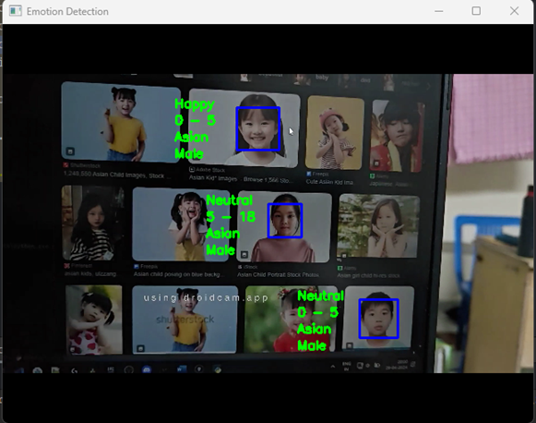
Output Images

Slide 19
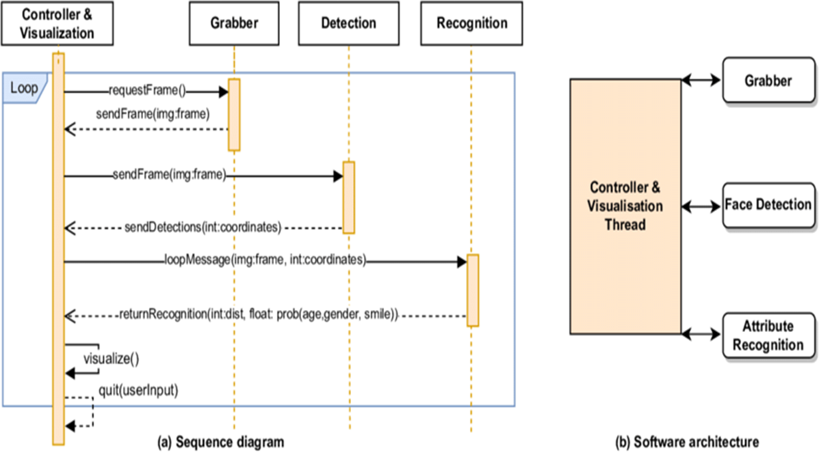
UML Diagram

Slide 20
Code Links
https://github.com/prerakl123/Emotion-Age-Gender-Ethnicity-Prediction/blob/master/modelled/seq_dcnn_fer.ipynb
https://github.com/prerakl123/Emotion-Age-Gender-Ethnicity-Prediction/blob/master/modelled/seq_dcnn_aeg.ipynb
https://github.com/prerakl123/Emotion-Age-Gender-Ethnicity-Prediction/blob/master/modelled/predict.py

